Slide 1
Capstone Project-3 (SUPERVISED CLASSIFICATION)
HEALTH INSURANCE CROSS SELLS PREDICTION INDIVIDUAL PROJECT BISWAJIT GOCHHAYAT

Slide 2
CONTENT
INTRODUCTION TO ML CLASSIFICATION
PROBLEM STATEMENT
DATA SUMMARY
DATA DESCRIPTION
DATA PREPARATION
EDA(UNIVARIATE,BIVARIATE,MULTIVARIATE)
BEFORE ML STEPS
ML MODEL IMPLEMENTATION
CHALLENGE
CONCLUSION

Slide 3
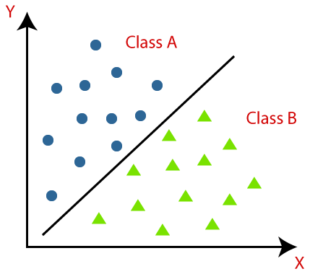
INTRO TO ML /ML CLASSIFACTION:
Classification is a process of categorizing a given set of data into classes, It can be performed on both structured and unstructured data. The process starts with predicting the class of given data points. The classes are often referred to as target, label, or categories
the ml classification is divided into two categories a)Binary and b)multiclass
And we are going to solve a multiclass classification.

Slide 4
PROBLEM STATEMENT
A Insurance company that has provided Health Insurance to its customers now need to help in building a model to predict whether the customers from
the past year will also be interested in Vehicle Insurance provided by the
company.

Slide 5
DATA SUMMARY:
1. id : Unique ID for the customer 2. Gender : Gender of the customer
3. Age : Age of the customer
4. Driving_License 0 : Customer does not have DL, 1 : Customer already has DL
5. Region_Code : Unique code for the region of the customer
6. Previously_Insured : 1 : Customer already has Vehicle Insurance, 0 : Customer doesn't have Vehicle Insurance
7. Vehicle_Age : Age of the Vehicle
8. Vehicle_Damage :1 : Customer got his/her vehicle damaged in the past.
0 : Customer didn't get his/her vehicle damaged in the past.
9. Annual_Premium : The amount customer needs to pay as premium in the year
10. PolicySalesChannel : Anonymized Code for the channel of outreaching to the customer ie. Different Agents, Over Mail, Over Phone, In Person, etc. 11. Vintage : Number of Days, Customer has been associated with the company
12. Response : 1 : Customer is interested, 0 : Customer is not interested

Slide 6
DATA DESCRIPTION :
Number of rows:2000
Number of columns:21
Missing values:0
Missing values (%):0%
Checking Duplicate values: 0

Slide 7
EXPLORATORY DATA ANALYSIS :
EDA :
1. UNIVARIATE ANALYSIS
2. BIVARIATE ANALYSIS
3. MULTIVARIATE ANALYSIS

Slide 8
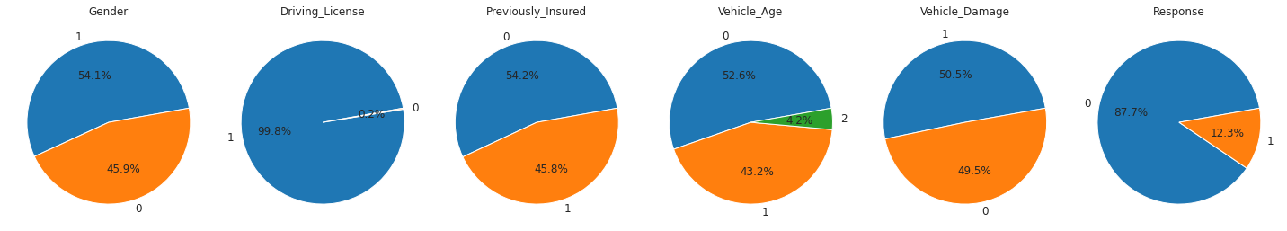
UNIVARIATE ANALYSIS

Slide 9
OBSERVATION :
# male-1 female-2
# Vehicle_Age >2 =2 1-2 = 0 <1 = 1
# Vehicle_Damage 1 = yes, 0= no
1. 54.1% of males and 45.9% of females are present in cross-sell data set
2. 99.8% of people have their own dl
3. more than 50% of people have noted their insurance
4. 52.6% of vehicles are in between 1 to2 year.
5. The ratio of damage to vehicles and non-damage to vehicle are approximately the same
6. 87.6 % of people are not shown their interest in the response of insurance.

Slide 10
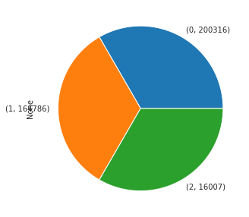
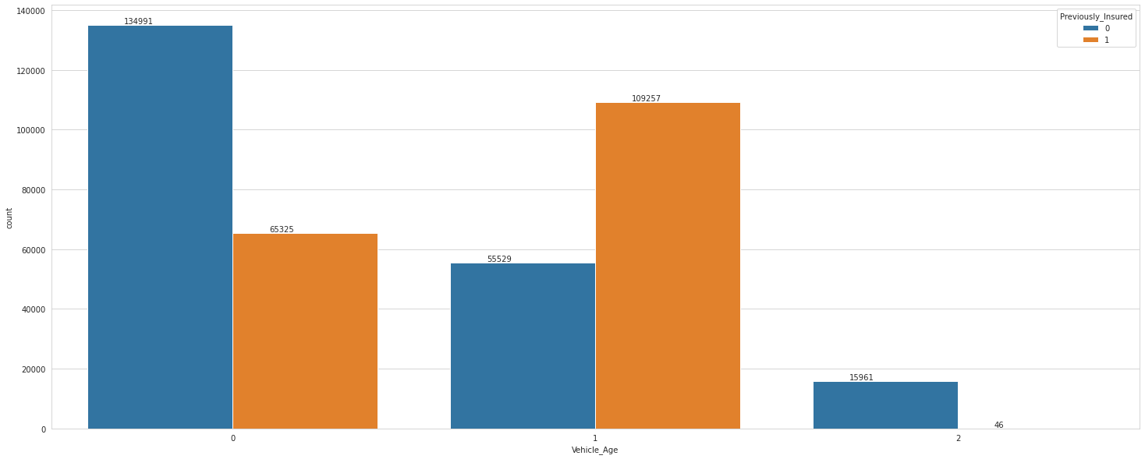
BIVARIATE ANALYSIS:
Q. which age of vehicle age has most frequent in previously insured?
Q . which age of vehicle age has more vehicle damage. ?
Vehicle age <=1 that is 1 has more number of
previously insured.
Vehicle age 1-2 i.e. 0 have more number of vehicle damage

Slide 11
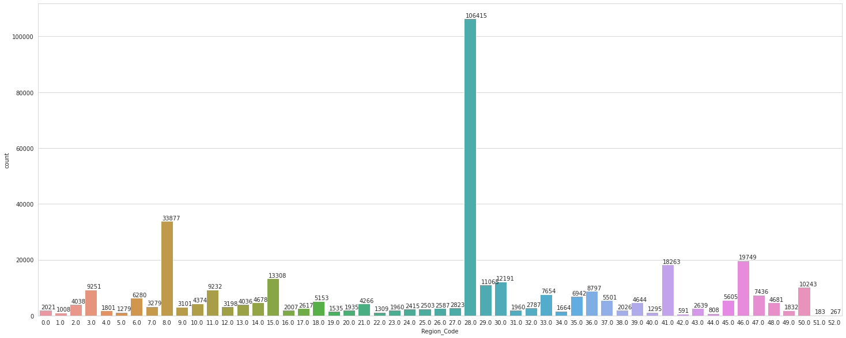
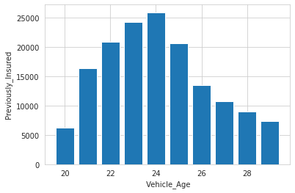
Q. Which age of the customer has been associated with the company?
which region code has the high number of customers?
Age 22 to 25 age of customer have more associated with the company?
Region code 106415 have high number of customer .

Slide 12
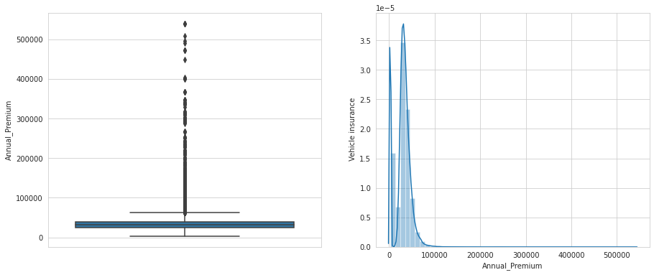
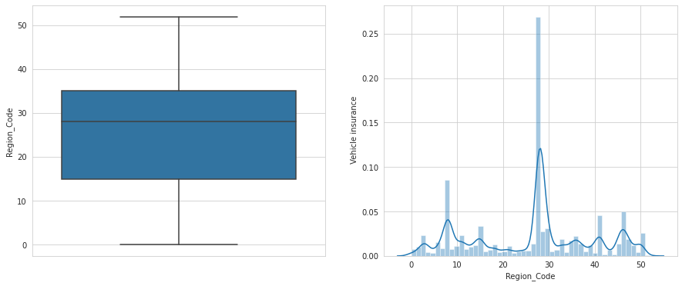
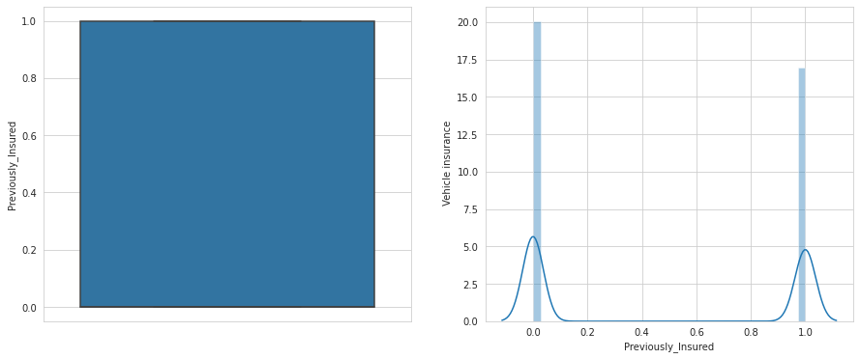
Finding Outliers and Skewness :

Slide 13
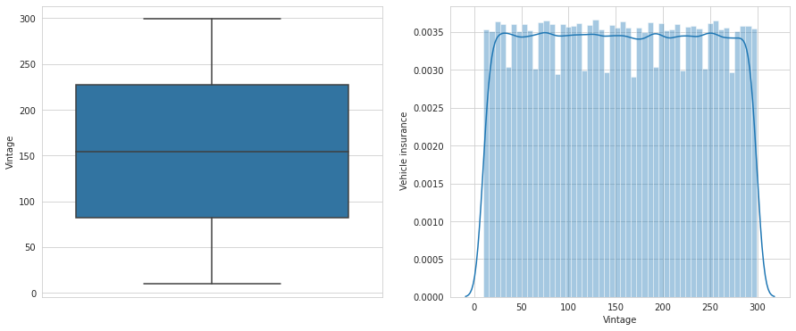
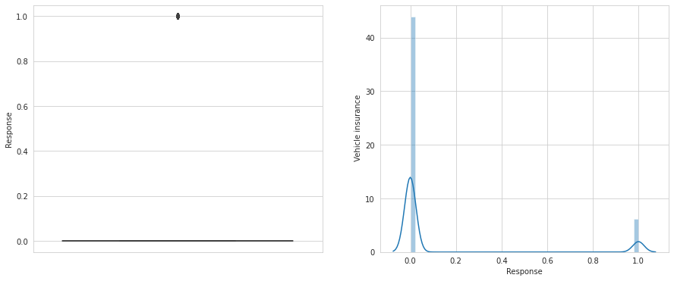

Slide 14
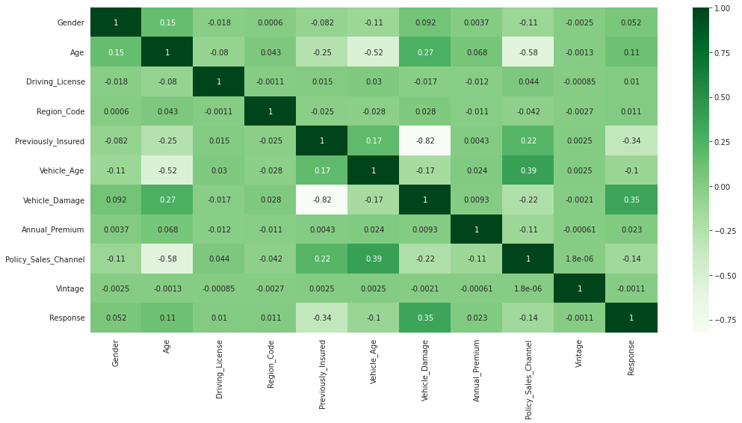
Finding co-relation of column :

Slide 15
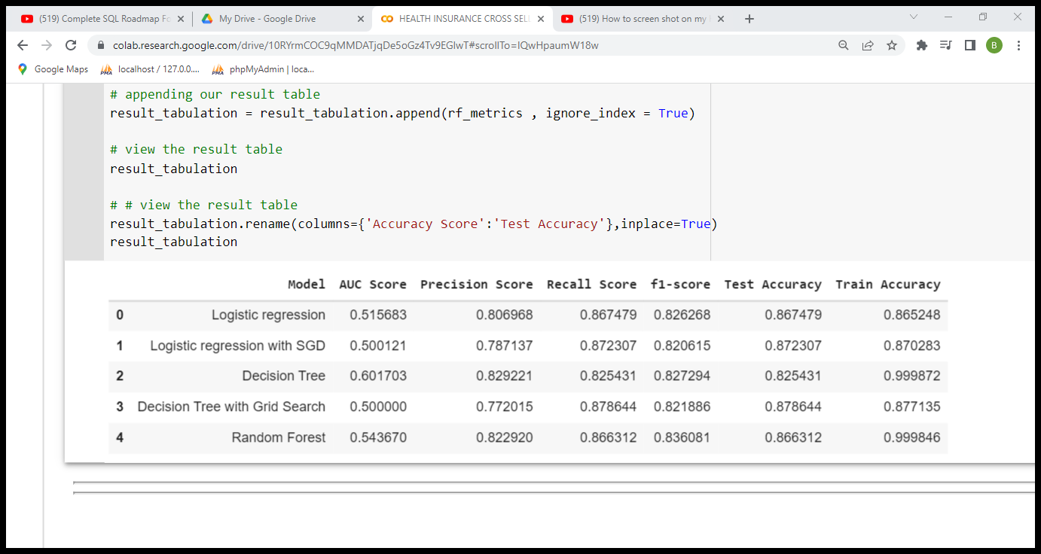
MODELLING :
WITHOUT FEATURE SELACTION
ELLINGMODELLINGMODELLINGDELLING

Slide 16
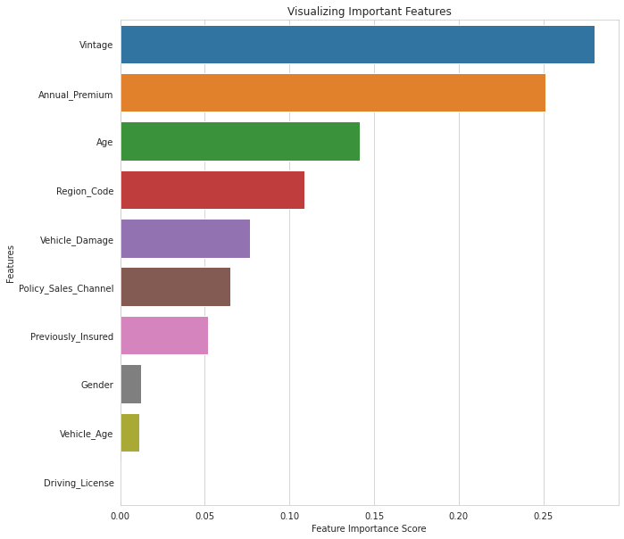
FEATURE SELACTION :

Slide 17
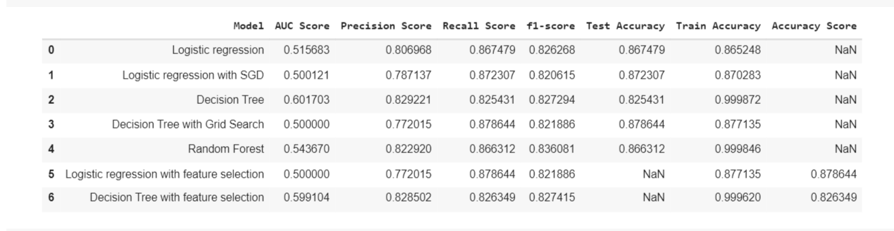
MODELLING :
AFTER FEATURE SELECTION

Slide 18
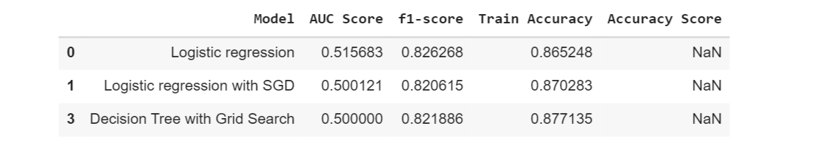
BEST PERFORMING MODELS :

Slide 19
OBSERVATION FOR ML MODEL IMPLEMENTATION:
The performance of the model is measured using precession and recall and with the help of feature selection, and accuracy score .from the above table, it can be seen that Logistic Regression and Logistic regression with GDS have a good score. With the help of feature selection, we got only the Decision Tree with greed search cv gives us also a good model. We consider all these 3 models for our model validation.

Slide 20
THANK YOU

